Slide 1
RCSS 4th Grade Problem of the Day 2025-2026
Teaching and Learning: Numeracy

Slide 2
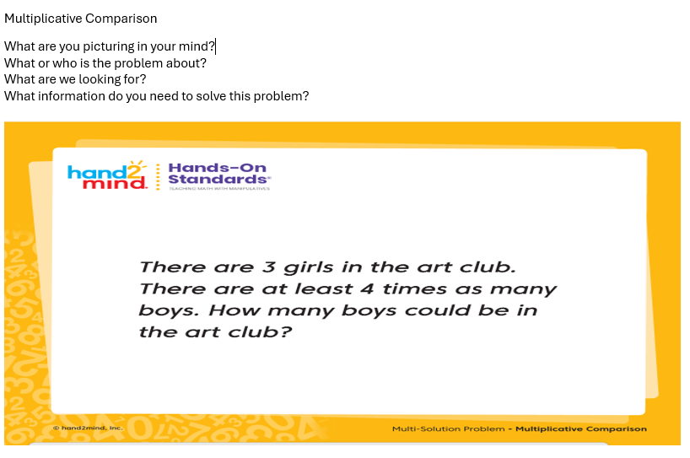
Week 10: POD: Day 1

Slide 3
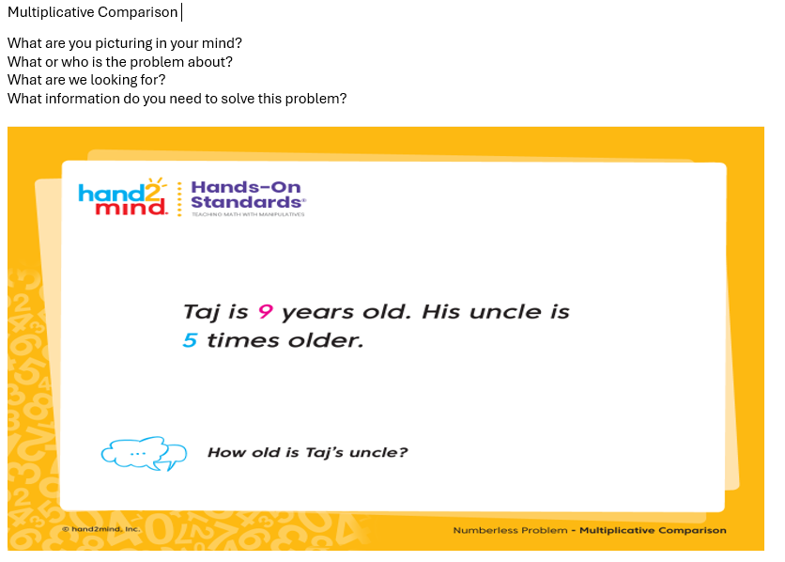
Week 10: POD: Day 2

Slide 4
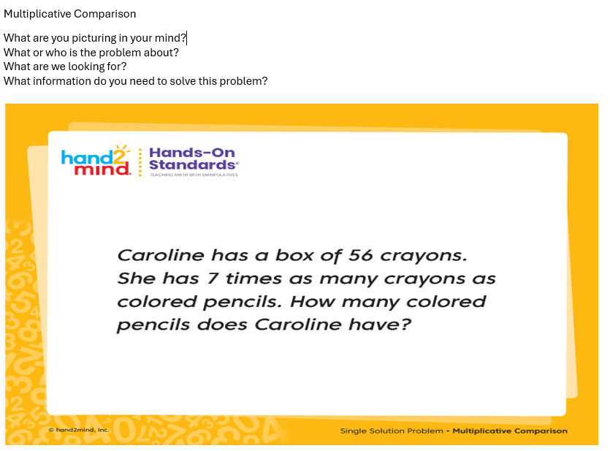
Week 10: POD: Day 3

Slide 5
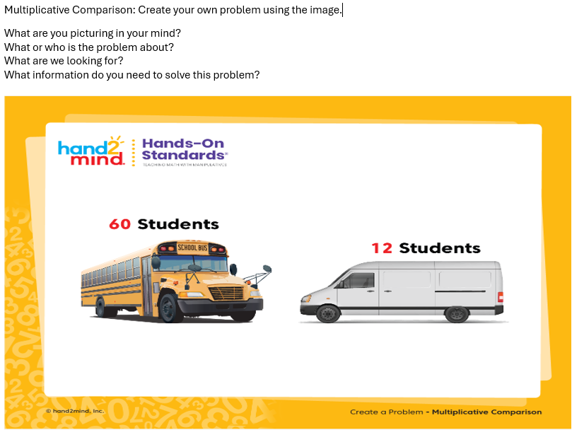
Week 10: POD: Day 4

Slide 6
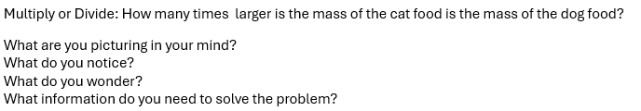
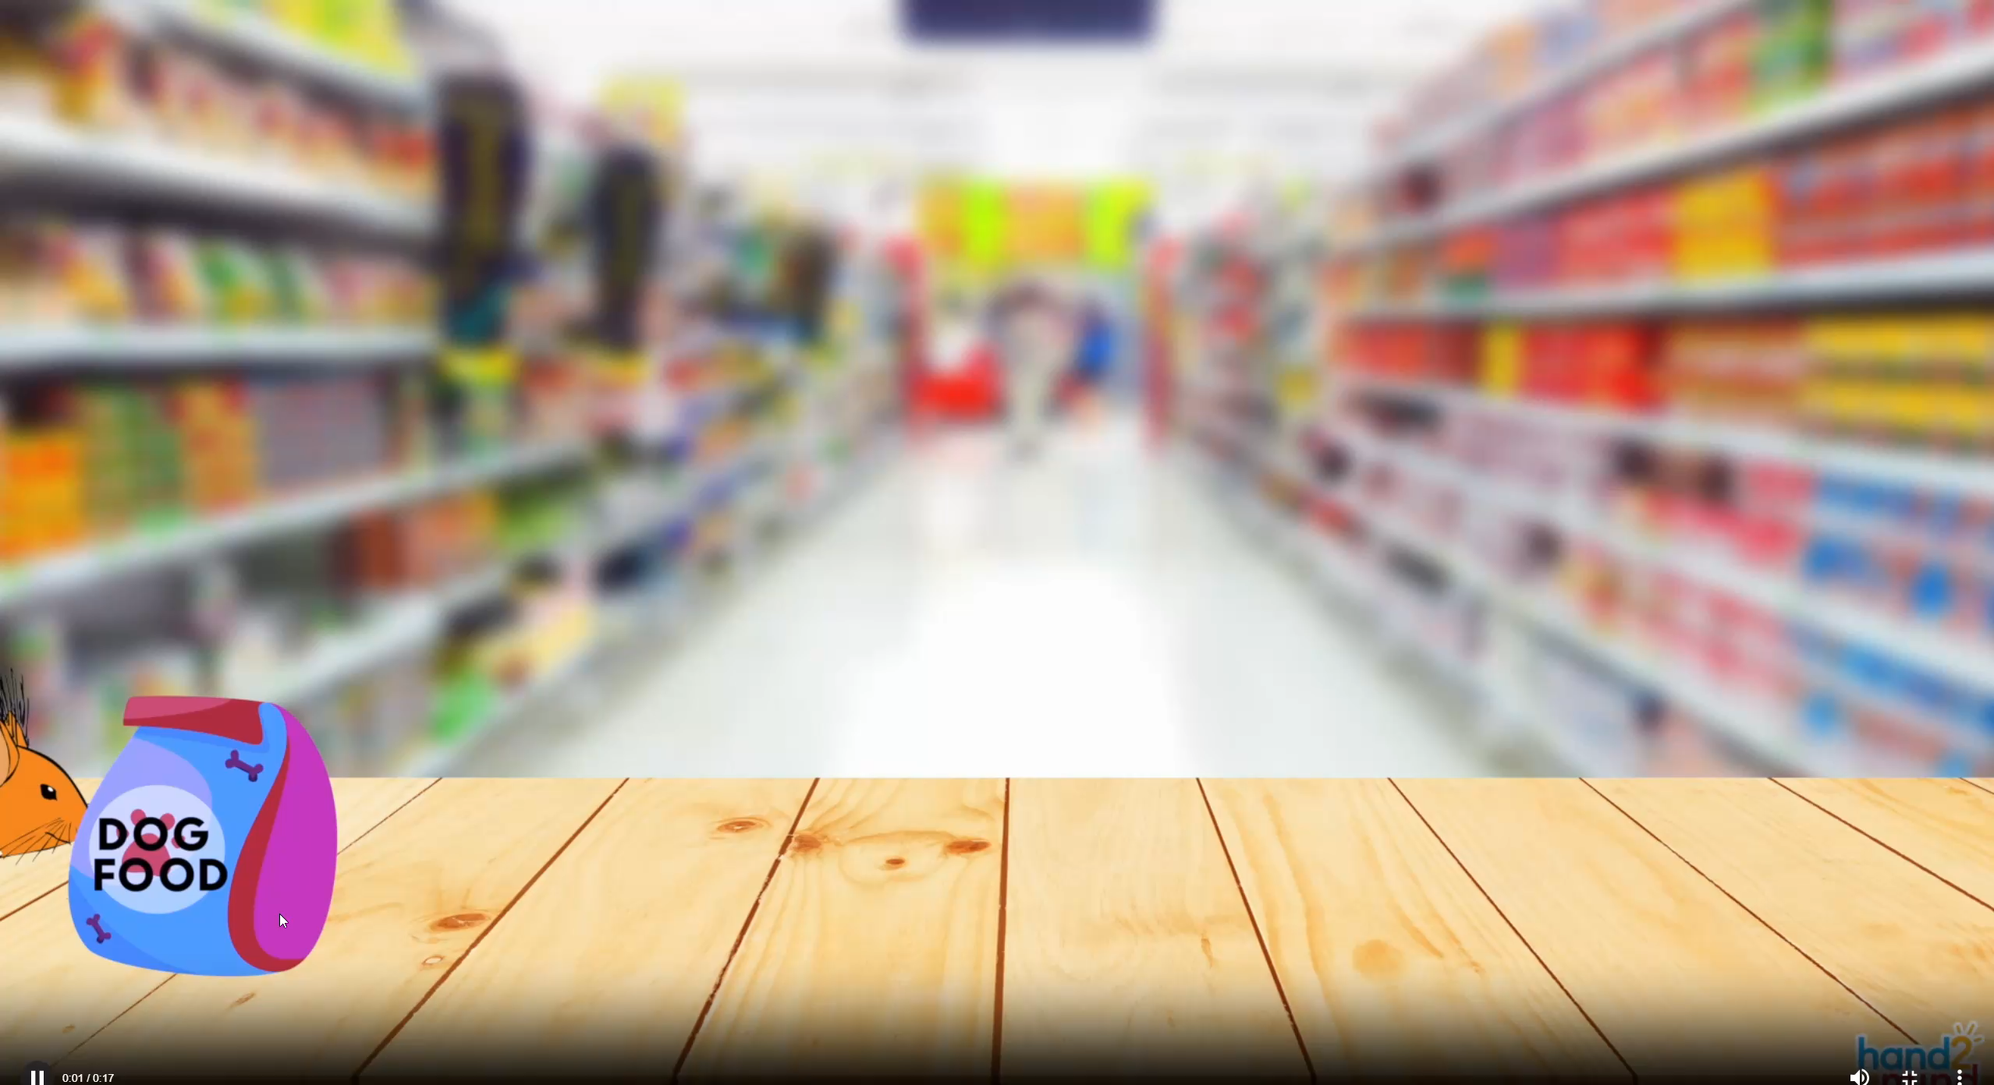
Week 10: POD: Day 5
Video Problem

